Slide 1


Introduction to System Security
SE3331-1 (2025 Fall)
IPADS, Shanghai Jiao Tong University
https://www.sjtu.edu.cn
Notes:
Credits to Mike Freedman (COS 461) and others.

Slide 2
Attacks Happen
Lots of personal info stolen
  Attackers broke into server w/ ~800K records on Utah patients
Phishing attacks
  Users at ORNL tricked by phishing email about benefits from HR
Millions of PCs are under control of an adversary
  Which is called "Botnet"
Stuxnet
  Infected Iran's uranium processing facilities
  Fake certificate

Slide 3


Slide 4
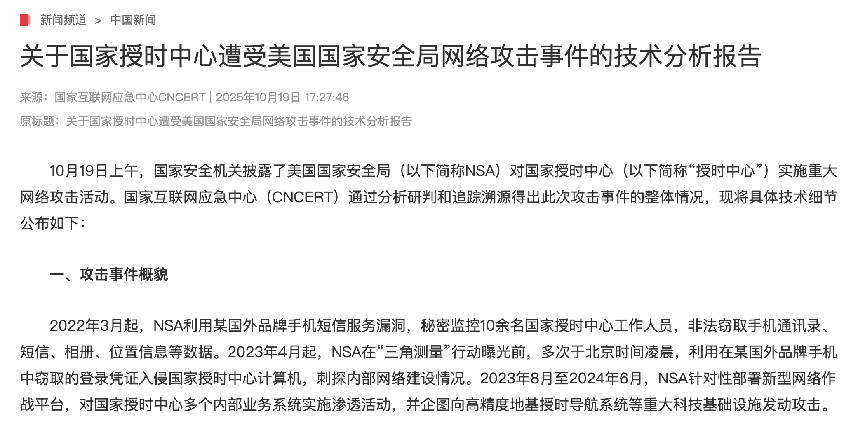

Slide 5
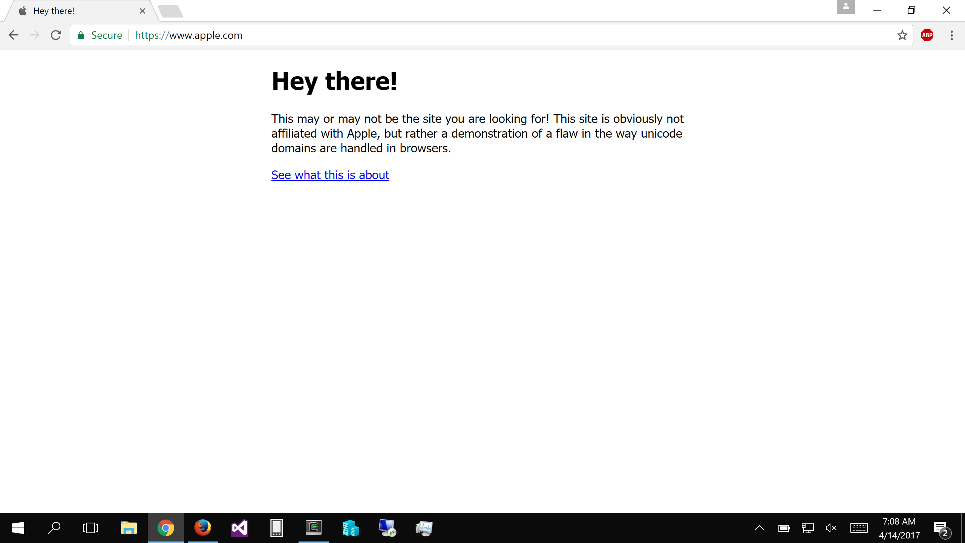
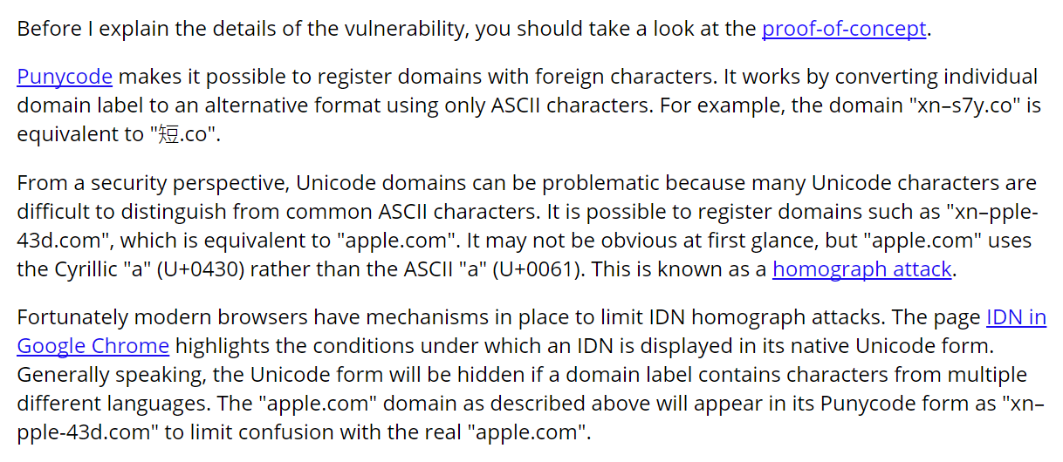

Slide 6
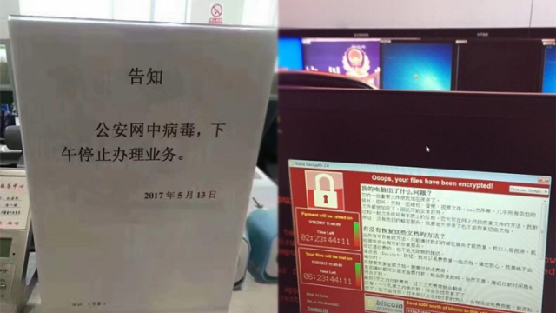

Slide 7
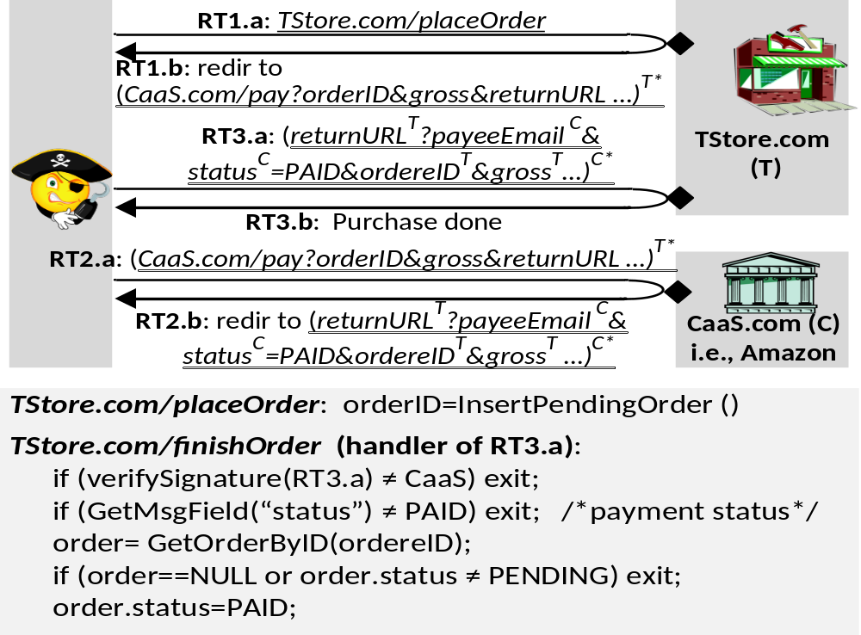



.
HOW TO SHOP FOR FREE ONLINE (S&P'11)
Chuck, pay in Amazon with this signed letter:
Amazon, I want to pay with this letter
Great, I will ship order#123!
Dear Amazon,
order#123 is $10, when it is paid, text me at 425-111-2222. [Jeff's signature]
Jeff,
I want to buy this DVD.
Dear Amazon,
order#123 is $10, when it is paid, text me at 425-111-2222. [Jeff's signature]
Jeff
Hi,
$10 has been paid for order#123.
[Amazon's signature]
Shopper Chuck
Amazon
Note: phone number is analogous to the URL that Amazon uses to notify the merchant

Slide 8
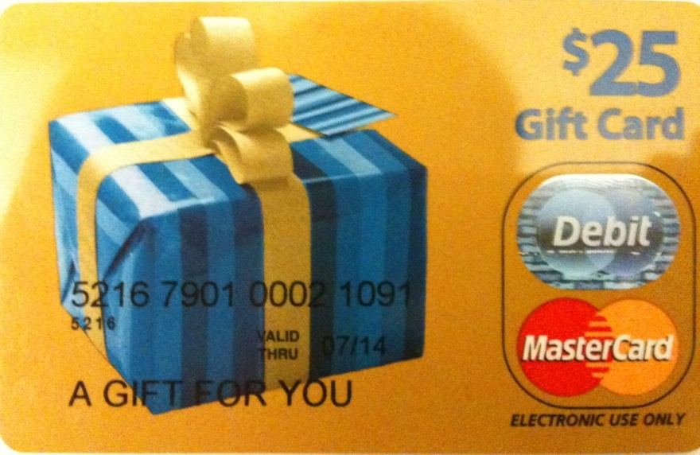



Flaw & exploit
Chuck, pay in Amazon with this signed letter:
Amazon, I want to pay with this letter
Dear Amazon,
order#123 is $10, when it is paid, text me at 425-111-2222.
[Jeff's signature]
Anyone can register an Amazon seller account, so can Chuck.
  We purchased a $25 MasterCard gift card by cash
  We registered it under the name "Mark Smith" with fake address/phone number
  Registered for seller accounts in PayPal, Amazon and Google using the card
Great, I will ship order#123!
Jeff,
I want to buy this DVD.
Dear Amazon,
order#123 is $10, when it is paid, text me at 425-111-2222. [Jeff's signature] [Mark's signature]
Jeff
Hi,
$10 has been paid for order#123.
[Amazon's signature]
Shopper Chuck
(and seller Mark)
Chuck's trick
  Pay to Mark (i.e., Chuck himself), but check out from Jeff
  Amazon is tricked to tell Jeff a payment between Chuck and Mark
  Jeff is confused by Amazon
Amazon
(CaaS)

Slide 9
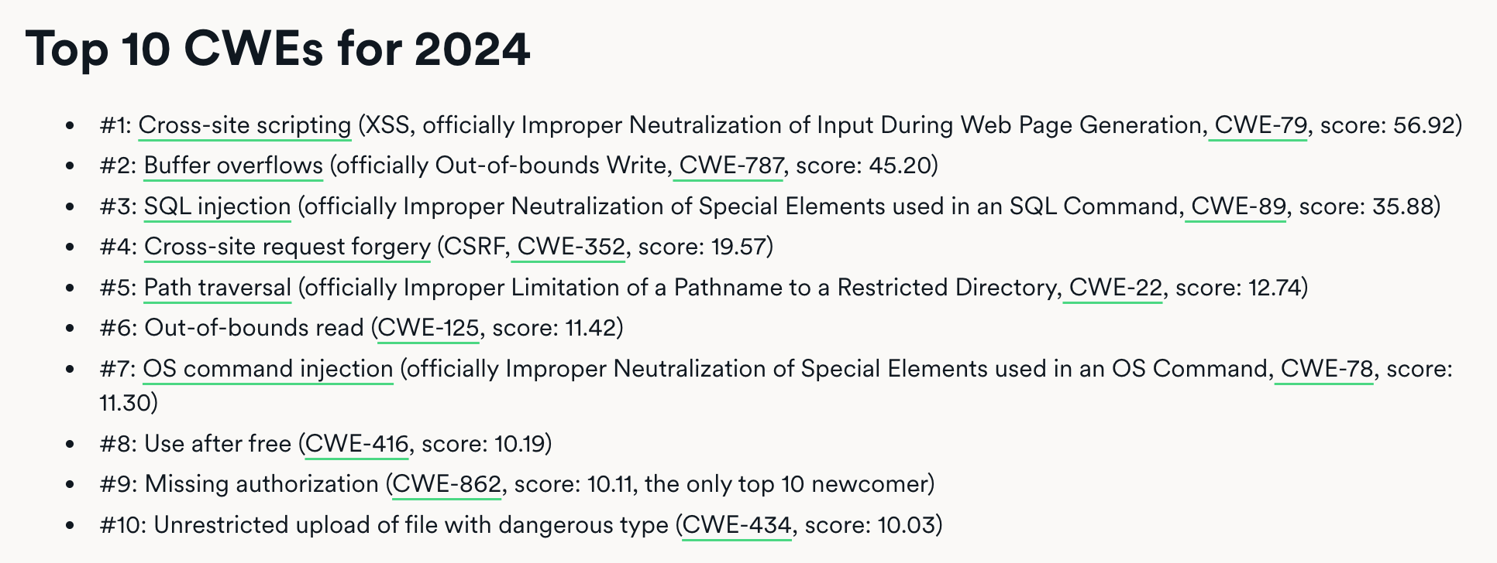
Other Attacks

Slide 10
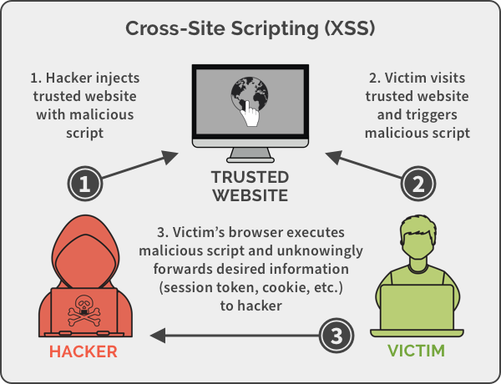
Cross-Site Scripting

Slide 11
SQL Injection
username | email | public?
yubin | yubin@sjtu.edu.cn | yes
mike | mcarbin@sjtu.edu.cn | yes
katrina | lacurts@sjtu.edu.cn | no
SELECT username, email FROM users WHERE
username='<username>' AND public='yes'
Let <username> = katrina' OR username='
SELECT username, email FROM users WHERE
username='katrina' OR username='' AND
public='yes'

Slide 12
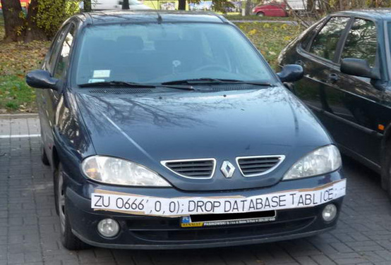
SQL Injection
ZU 0666',0,0);; DROP DATABASE TABLICE;

Slide 13
Security: Real World VS. Digital World
Security in general not a particularly new concern
  Banks, military, legal system, etc. have always worried about security
Similarities with computer security:
  Want to compartmentalize (different keys for bike vs. safe deposit box)
  Log and audit for compromises
  Use legal system for deterrence

Slide 14
Security: Real World VS. Digital World
Significant differences with computer security:
  Internet makes attacks fast, cheap, and scalable
    Huge number of adversaries: bored teenagers, criminals worldwide, etc.
    Anonymous adversaries: no strong identity on the internet
    Adversaries have lots of resources (compromised PCs in a botnet)
    Attacks can often be automated: systems compromised faster than can react
  Users often have poor intuition about computer security
    E.g., misunderstand implications of important security decisions

Slide 15
Why is Security So Hard?
Security is a negative goal
  Want to achieve something despite whatever adversary might do
A positive goal: "XYB can read exam.txt".
  Ask XYB to check if our system meets this positive goal
A negative goal: "Ben cannot read exam.txt".
  Ask John if he can read exam.txt?
  Good to check, but not nearly enough..
  Must reason about all possible ways in which John might get the data
How might Ben try to get the contents of exam.txt?
Notes:
We've seen negative goals already: all-or-nothing atomicity w/ crashes.
With crashes, just had to think of where we might crash.
Much harder to consider all possible cases with an adversary.
Security is also often hard because system has many complex goals.

Slide 16
Ways to Access exam.txt
Change permissions on exam.txt to get access
Access disk blocks directly
Access exam.txt via ipads.se.sjtu.edu.cn
Reuse memory after XYB's text editor exits, read data
Read backup copy of exam.txt from XYB's text editor
Intercept network packets to file server storing exam.txt
Send XYB a trojaned text editor that emails out the file
Steal disk from file server storing exam.txt
Get discarded printout of exam.txt from the trash
Call sysadmin, pretend to be XYB, reset his password
… when should we stop thinking of more ways?

Slide 17
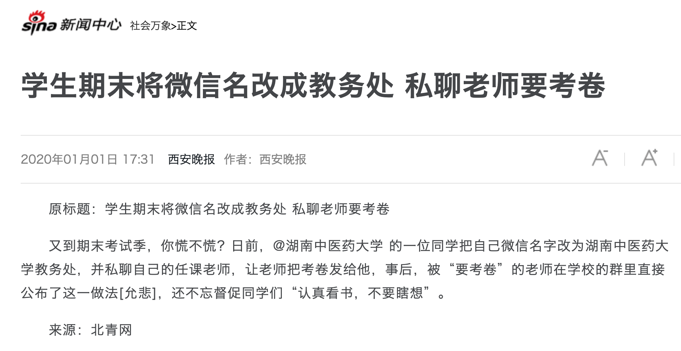

Slide 18
Why is Security So Hard?
Security sometimes conflicts with other goals
  Security VS. performance
  Security VS. availability
  Security VS. fault tolerance
  Security VS. convenience
  Security VS. simplicity
  ...

Slide 19
Fault Tolerant Fails Here
Why not using fault tolerant techniques for security?
  Some security issue can be seen as a kind of fault
  E.g., DoS attack
Two reasons
  The result of such “fault” may be too much (user cannot afford once)
    E.g., exam leakage, rocket launching
  Failures due to attack might be highly correlated
    In fault-tolerance, usually assume independent failures

Slide 20
Much Harder to Reason about Security
No complete solution; we can't always secure every system
  One solution: Trust nothing that you didn't create by yourself
What are we going to learn?
  How to model systems in the context of security
  How we think about and assess risks
  Techniques for assessing common risks
    There are things we can do to make systems more secure
  Know trade-offs
    Security vs. performance, security vs. convenience, and security vs. simplicity

Slide 21
2 Steps towards Building a More Secure System
How to make progress in building a secure system?
  Be clear about goals: "policy"
  Be clear about assumptions: "threat model"

Slide 22
Policy: Goals
Information security goals:
  Confidentiality: limit who can read data
  Integrity: limit who can write data
Liveness goals:
  Availability: ensure service keeps operating

Slide 23
Threat Model: Assumptions
Often don't know in advance who might attack, or what they might do
  Adversaries may have different goals, techniques, resources, expertise
Cannot be secure against arbitrary adversaries
  As we saw with Ben vs. XYB
  Adversary might be your hardware vendor, software vendor, administrator, …
  Need to make some plausible assumptions to make progress

Slide 24
Threat Model: Assumptions
What does a threat model look like?
  Adversary controls some computers, networks (but not all)
  Adversary controls some software on computers he doesn't fully control
  Adversary knows some information, such as passwords or keys (but not all)
  Adversary knows about bugs in your software?
  Physical attacks?
  Social engineering attacks?
  Resources? (Can be hard to estimate either resources or requirements!)

Slide 25
Threat Model: Assumptions
Unrealistic / incomplete threat models
  Adversary is outside of the company network / firewall
  Adversary doesn't know legitimate users' passwords
  Adversary won't figure out how the system works
Despite this, important to have a threat model
  Can reason about assumptions, evolve threat model over time
  When a problem occurs, can figure out what exactly went wrong and re-design
Overly-ambitious threat models not always a good thing
  Not all threats are equally important
  Stronger requirements can lead to more complexity
  Complex systems can develop subtle security problems

Slide 26

Guard Model

Slide 27
Guard Model of Security
Complete mediation
  Only way to access the resource involves the guard
  1. Must enforce client-server modularity
    Adversary should not be able to access server's resources directly
    E.g., assume OS enforces modularity, or run server on separate machine
  2. Must ensure server properly invokes the guard in all the right places

Slide 28
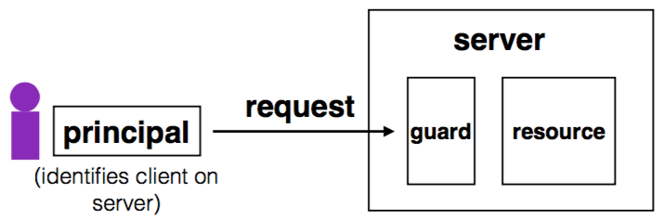
Complete Mediation
Guard typically provides:
  Authentication: is the principal who they claim to be?
  Authorization: does principal have access to perform request on resource?

Slide 29
Designing the Guard
Two functions often provided by a guard:
  Authentication: request -> principal
    E.g., client's username, verified using password
  Authorization: (request, principal, resource) -> allow?
    E.g., consult access control list (ACL) for resource
Simplifies security
  Can consider the guards under threat model
  But don't forget about complete mediation

Slide 30
Example: Unix FS
Resource: files, directories.
Server: OS kernel.
Client: process.
Requests: read, write system calls.
Mediation: U/K bit / system call implementation.
Principal: user ID.
Authentication: kernel keeps track of user ID for each process.
Authorization: permission bits & owner uid in each file's inode.

Slide 31
Example: Web Server
Resource: Wiki pages
Client: any computer that speaks HTTP
Server: web application, maybe written in Python
Requests: read/write wiki pages
Mediation: server stores data on local disk, accepts only HTTP reqs
Principal: username
Authentication: password
Authorization: list of usernames that can read/write each wiki page
Notes:
Note: requires setting file permissions, etc; assumes OS kernel provides complete mediation.

Slide 32
Example: Firewall
Resource: internal servers
Client: any computer sending packets
Server: the entire internal network
Requests: packets
Mediation:
  internal network must not be connected to internet in other ways
  no open wifi access points on internal network for adversary to use
  no internal computers that might be under control of adversary
Principal, authentication: none
Authorization: check for IP address & port in table of allowed connections

Slide 33
What Can Go Wrong?
1. Bypass complete mediation by software bugs
2. Bypass complete mediation by an adversary
3. Policy vs. mechanism
4. Interactions between layers, components
5. Users make mistakes
6. Cost of security

Slide 34
Bypassing Complete Mediation
All ways to access resource must be checked by guard
  Common estimate: one bug per 1,000 lines of code
  Adversary may trick server code to do something unintended, bypass guard
How to prevent bypassing?
  Reduce complexity: reduce lines of code
  The "principle of least privilege"

Slide 35
Example: Paymaxx.com (2005)
https://my.paymaxx.com/
  Requires username and password
  If you authenticate, provides menu of options
  One option is to get a PDF of the tax form
https://my.paymaxx.com/get-w2.cgi?id=1234
  Gets a PDF of W2 tax form for ID 1234
get-w2.cgi forgot to check authorization
  Attacker manually constructs URLs to fetch all data

Slide 36
Authentication: Password

Slide 37
Authentication: Who Are You?
Something you know
  E.g., passwords, answers of questions
Something you have
  E.g., keys or smart cards
Something you are
  E.g., fingerprint, iris, or other biometric method
Q: What are their pros and cons?

Slide 38
Authentication: Password
Password goals
  Authenticate user
  Adversary must guess
    For random 8-letter passwords, ~26⁸?
  Guessing is expensive

Slide 39
An Example: Guessing Password (Tenex)
checkpw (user, passwd):
acct = accounts[user]
for i in range(0, len(acct.pw)):
if acct.pw[i] ≠ passwd[i]:
return False
return True
passwd:
P
A
S
S
W
O
R
D
X
acct.pw:
P
A
S
S
w
O
R
D

Slide 40
Problem: Guess One Character at a Time
Guess a password
  Allocate password 1 byte away from a page boundary
  Page-fault means first char is OK
  Example of cross-layer interactions
Problem: server has a copy of all passwords
  If adversary exploits buffer overflow, can get a copy of all passwords

Slide 41
Timing Attack: Guess One Character at a Time
Guess a password
  Allocate password 1 byte away from a page boundary
  Page-fault means first char is OK
  Example of cross-layer interactions
Also known as "Timing Attack"

Slide 42

Timing Attack: Guess One Character at a Time
Page in Memory
a
b
c
ca
…
cs
…
Page on Disk -> Page Fault
aaaaaa
aaaaaa
aaaaaa
aaaaa
aaaaa
Time = 1ms
Time = 1ms
Time = 10ms
Time = 1ms
Time = 10ms
Page Fault!
The 1st char must be 'c'
Page Fault!
The 2nd char must be 's'

Slide 43
Idea: Store Hash of Password
Hash functions: arbitrary strings to fixed-length output
  Common output sizes are 160 bits, 256 bits, ..
  One-way: given H(x), hard to recover x
  Collision-resistant: hard to find different x and y such that H(x)=H(y)
  Evolve over time: SHA-0 and MD-5 used to be popular, now considered broken

Slide 44
Store Hash of Password
Accounts database stores hash of every user's password
Compute hash, check if the hash matches
Solves not only the password theft problem, but also the page-fault attack

Slide 45
Store Hash of Password
username | hash(password)
arya | de5aba604c340e1965bb27d7a4c4ba03f4798ac7
jon | 321196d4a6ff137202191489895e58c29475ccab
Sansa | 6ea7c2b3e08a3d19fee5766cf9fc51680b267e9f
hodor | c6447b82fbb4b8e7dbcf2d28a4d7372f5dc32687
check_password(username, inputted_password):
stored_hash = accounts_table[username]
inputted_hash = hash(inputted_password)
return stored_hash == inputted_hash

Slide 46
Store Hash of Password
What happens if an adversary breaks into a popular web site
with 1M accounts?
  Adversary steals 1M hashes
  Problem: adversary can guess each password one-by-one
  Problem: worse yet, adversary can build table of hashes for common passwords
  Often called a "rainbow table"
  Users are not great at choosing passwords, many common choices

Slide 47
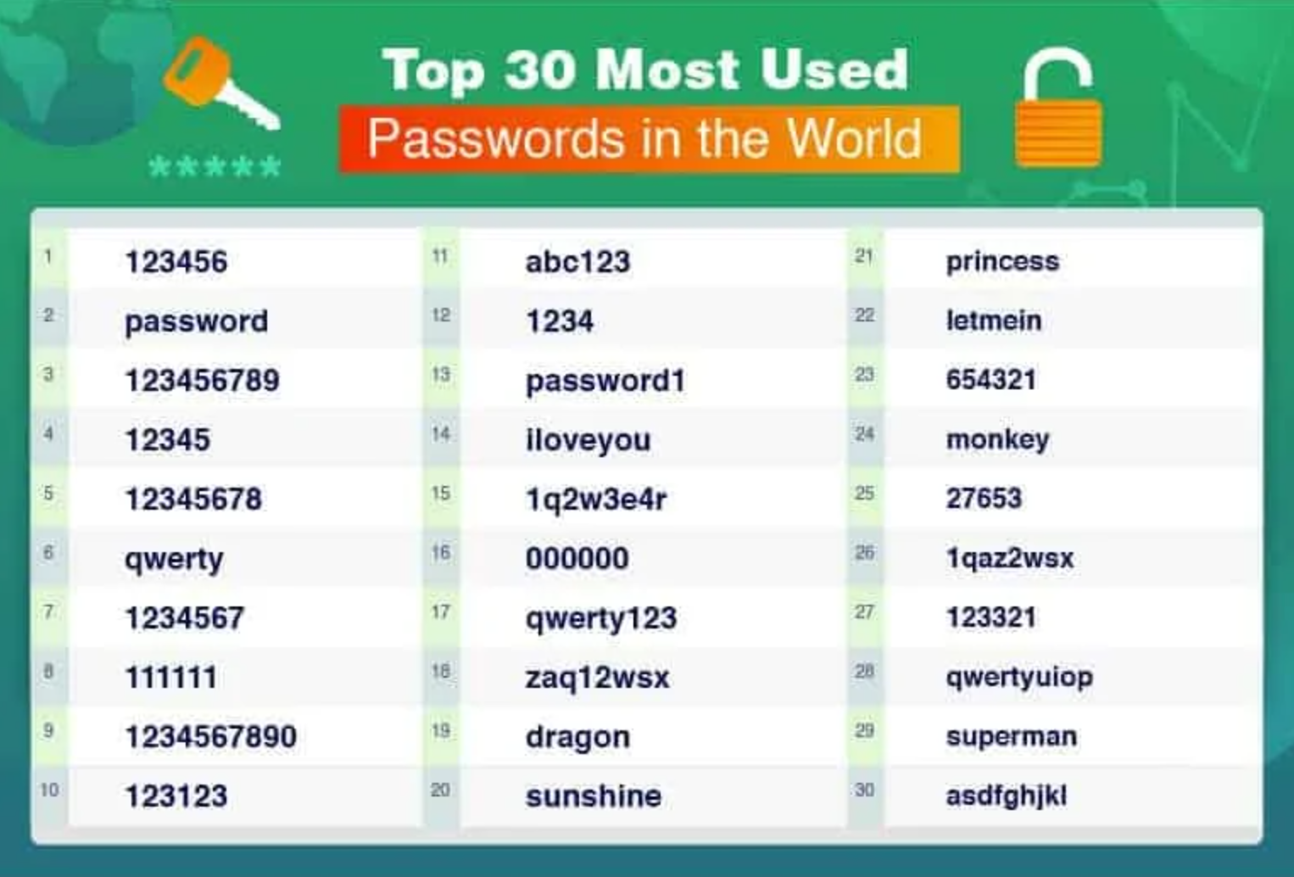
30 Most Used Passwords in 2022

Slide 48
Store Hash of Password
Important to think of human factors when designing security systems
  Not much we can do for users that chose "123456"
  Plenty of bad passwords have numbers, uppercase, lowercase, etc.
  What matters is the (un)popularity of a password, not letters/symbols
  But we can still make it a bit harder to guess less-embarrassing passwords

Slide 49
Salting
Salting: make the same password have different hash values
  Makes it harder to build a pre-defined lookup table
Choose random salt value when storing the password (& store the salt)
  Store hash of salt and password together
  Use the original salt to compute a matching hash when verifying password
  Every password has many possible hash values -> impractical to build rainbow table
Use a much more expensive hash function
  For reference: look up "bcrypt" by Provos and Mazieres

Slide 50
Salting
username | salt | hash(password | salt)
arya | 5334900209 | c5d2a9ffd6052a27e6183d60321c44c58c3c26cc
jon | 1128628774 | 624f0ffa577011e5704bdf0760435c6ca69336db
Sansa | 8188708254 | 5ee2b8effce270183ef0f4c7d458b1ed95c0cce5
Hodor | 6209415273 | f7e17e61376f16ca23560915b578d923d86e0319
check_password(username, inputted_password)
stored_hash = accounts_table[username]
inputted_hash = hash(inputted_password | salt)
return stored_hash == inputted_hash

Slide 51
Bootstrap Authentication
Do not want to continuously authenticate with password for every command
  Typing, storing, transmitting, checking password: risk of compromise
In Unix login:
  Login process exchanges password for userid
In web applications:
  Often exchange password for a session cookie
  Can think of it as a temporary password that's good for limited time

Slide 52
Session Cookies: Strawman
First check username and password, if ok, send:
Use the tuple to authenticate user for a period of time
  Nice property: no need to store password in memory, or re-enter it often
  Server_key is there to ensure users can't fabricate hash themselves
  Arbitrary secret string on server, can be changed (invalidating cookies)
  Can verify that the username and expiration time is valid by checking hash
{username, expiration, H(server_key | username | expiration)}

Slide 53
Session Cookies: Strawman
Problem: the same hash can be used for different username/expiration pairs!
  E.g., "Ben" and "22-May-2012" may also be "Ben2" and "2-May-2012"
  Concatenated string used to compute the hash is same in both cases!
  Can impersonate someone with a similar username
Principle: be explicit and unambiguous when it comes to security
  E.g., use an invertible delimiter scheme for hashing several parts together

Slide 54
Phishing Attacks
Adversary tricks user into visiting legitimate-looking web site (e.g., bank)
  Asks for username/passwd
  Actually a different server operated by adversary
    E.g., bank0famerica.com instead of bankofamerica.com
  Stores any username/passwd entered by victims
  Adversary can now impersonate victims on the real web site

Slide 55
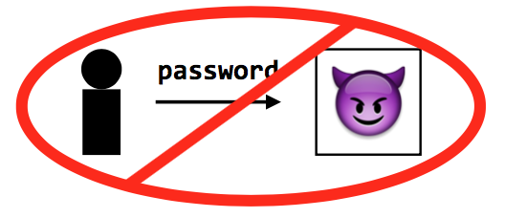
Key Problem of Password
Key problem: once you send a password to the server, it can impersonate you
  Solved part of the problem by hashing the password database
  But still sending the password to the server to verify on login

Slide 56
Tech 1: challenge-response scheme
Challenge-response
  Server chooses a random value R, sends it to client
  Client computes H(R + password) and sends to server
  Server checks if this matches its computation of hash with expected password
  If the server didn't already know password, still doesn't know

Slide 57
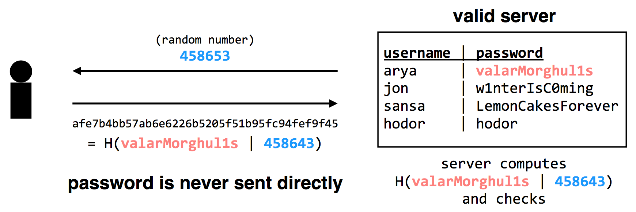
Tech 1: challenge-response scheme
Adversary only learns H(valarMorghul1s | 458643); can not recover the password from that

Slide 58
Tech 2: use passwords to authenticate the server
Make the server prove it knows your password
  Client chooses Q, sends to server, server computes H(Q + password), replies
  Only the authentic server would know your password!
Unfortunately, not many systems use this in practice
  In part because app developers just care about app authenticating user...
Notes:
Slight problem: simple challenge-response can't be used with hashed passwords.
Need the original password to compute hash together with random challenge.
If we store the hashed password, its hash now becomes the effective password..
There's a protocol that allows both.
Store a "hash" of password, challenge-response auth.
Look up "SRP" if building a real system (details too complicated for 6.033).

Slide 59
Tech 2: use passwords to authenticate the server
Complication: could be used with first scheme to fool server!
  First, try to log into the server: get the server's challenge R
  Then, decide you want to test the server: send it the same R
  Send server's reply back to it as response to the original challenge
Principle: be explicit, again!
  E.g., hash the intended recipient of response (e.g., client or server), and have the recipient verify it
Notes:
Slight problem: simple challenge-response can't be used with hashed passwords.
Need the original password to compute hash together with random challenge.
If we store the hashed password, its hash now becomes the effective password..
There's a protocol that allows both.
Store a "hash" of password, challenge-response auth.
Look up "SRP" if building a real system (details too complicated for 6.033).

Slide 60
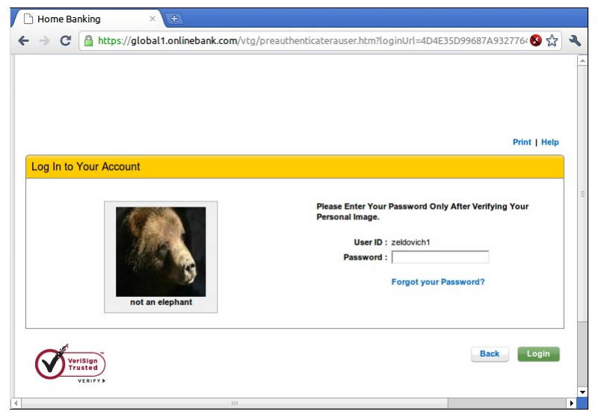
Tech 3: turn offline into online attack
Turn phishing attacks from offline into online attacks
  If adversary doesn't have the right image, users will know the site is fake
  Adversary could talk to real site, fetch image for each user that logs in

Slide 61
Tech 3: turn offline into online attack
Why is it still useful, then?
  Requires more efforts on adversary's part to mount attack
  Even if adversary does this, bank can detect it
  Watch for many requests coming from a single computer
  That computer might be trying to impersonate site
  Turns an offline/passive attack into an online/active attack
Key insight
  Don't need perfect security, small improvements can help

Slide 62
Tech 4: Specific password
Make passwords specific to a site
  Instead of sending password, send H(servername + password)
  Just like a basic password scheme, from the server's point of view
Except impersonator on another server gets diff passwd

Slide 63
Tech 5: one-time passwords
One-time Password
  If adversary intercepts password, can keep using it over and over
  Can implement one-time passwords: need to use a different password every time
Design: construct a long chain of hashes.
  Start with password and salt, as before
  Repeatedly apply hash, n times, to get n passwords
  Server stores x = H(H(H(H(...(H(salt+password)))))) = H^{n}(salt+password)
To authenticate, send token=H^{{n-1}}(salt+password)
  Server verifies that x = H(token), then sets x <- token
  User carries a printout of a few hashes, or uses smartphone to compute them.

Slide 64
Tech 5: one-time passwords
Alternative design: include time in the hash (Google's 2-step verification)
  Server and user's smartphone share some secret string K
  To authenticate, smartphone computes H(K || current time)
  User sends hash value to server, server can check a few recent time values.

Slide 65
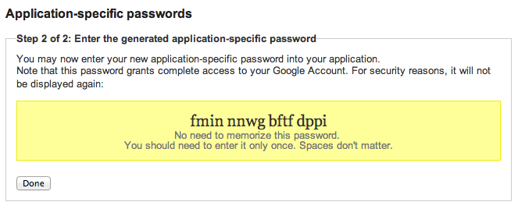

Google's App-specific password

Slide 66
Tech 6: bind authentication and request authorization
One way to look at problem: sending password authorizes any request
  Even requests by adversary that intercepts our password
  A different design: use password to authenticate any request
  req = { username, "write XX to exam.txt", H(password + "write ..") }
Server can check if this is a legitimate req from user using password
  Even if adversary intercepts request, cannot steal/misuse password
  In practice, don't want to use password, use some session token instead
  Could combine well with one-time passwords

Slide 67
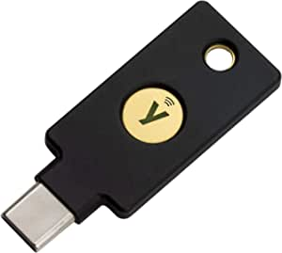
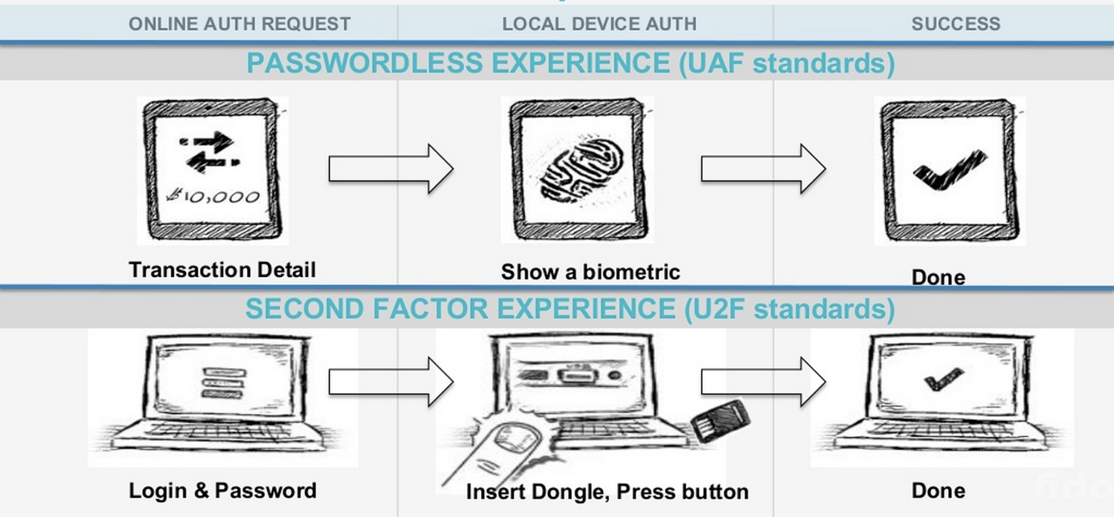
Tech 7: FIDO: Replace the Password

Slide 68
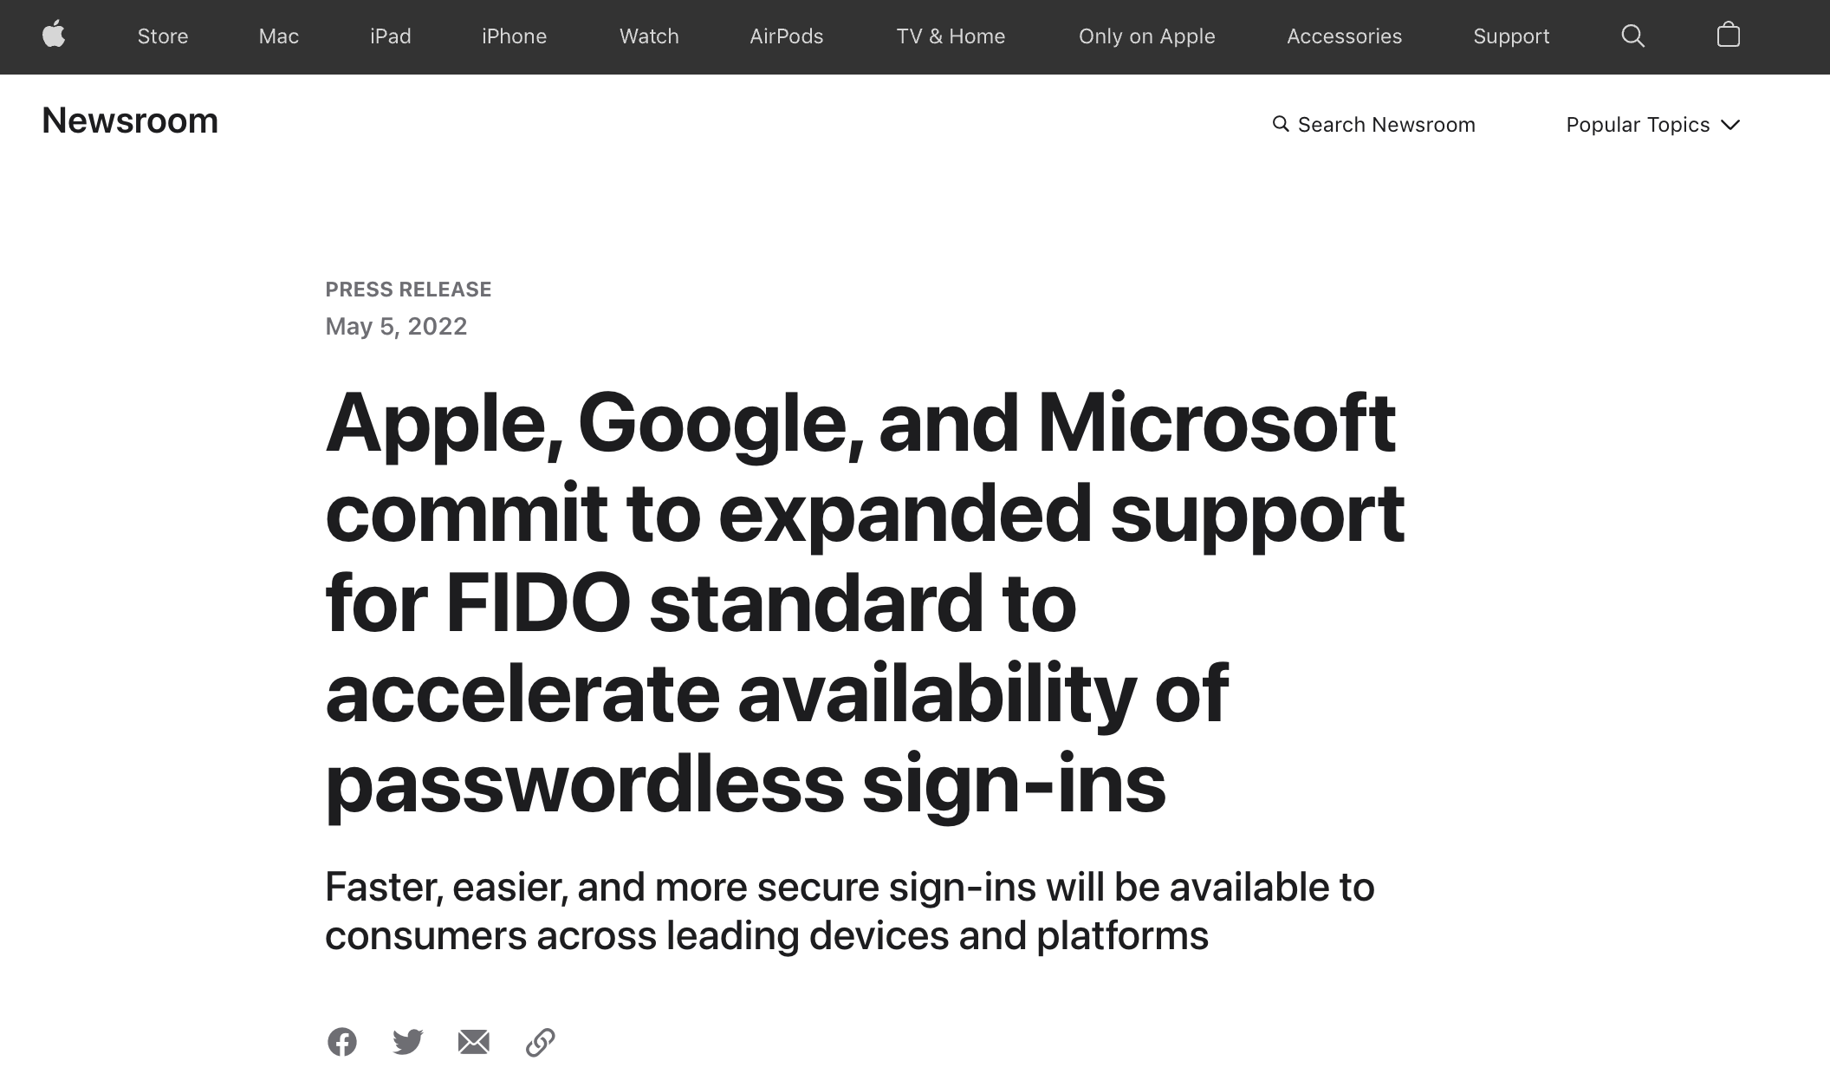

Slide 69
Three Bindings
Fingerprint
User ID
Private key
Publish key
Phone
Server
Secure by hardware (e.g., Enclave)
Secure by isolation

Slide 70
Bootstrapping
How to initially set a password for an account?
  If adversary can subvert this process, cannot rely on much else
  MIT: admissions office vets each student, hands out account codes
  Many web sites: anyone with an email can create a new account
Changing password (e.g., after compromise)
  Need some additional mechanism to differentiate user vs. attacker
  MIT: walk over to accounts office, show ID, admin can reset password
  Many sites: additional "security" questions used to reset password
Password bootstrap / reset mechanisms are part of the security system
  Can sometimes be weaker than the password mechanisms
  Sarah Palin's Yahoo account was compromised by guessing security Q's
  Personal information can be easy to find online

Slide 71
Security Principles

Slide 72
Principle of Least Privilege
Deal with bugs / incomplete mediation
  Any component that can arbitrarily access a resource must invoke the guard
  If component has a bug or design mistake, can lead to incomplete mediation
  General plan: reduce the number of components that must invoke the guard
    E.g., arrange for DB server to check permissions on records returned, then security does not depend as much on lookup.cgi

Slide 73
Least Trust
Privileged components are "trusted"
  Trusted is bad: you are in trouble if a trusted component breaks
  Untrusted components are good: does not matter if they break
  Good design has few trusted components, other things do not affect security

Slide 74
Users Make Mistakes
Social engineering, phishing attacks
  How many of you really read the permission acquired by apps during installing?
Good idea: threat model should not assume users are perfect

Slide 75
Cost of Security
Security VS. Availability
  E.g., system requires frequent password changes -> users may write them down
How far should a teacher go to protect the exam file?
  Put the file on a separate computer, to avoid sharing a file system?
  Disconnect computer from the network, to avoid remotely exploitable OS bugs?
  Put the server into a separate machine room?
  Get a guard to physically protect the machine room?
  ...
Good idea: cost of security mechanism should be commensurate with value
Notes:
Most security goals/policies not infinitely valuable, can tolerate attacks.
Security mechanisms can be expensive (e.g., wasted user time).

